Slide 1


Project 3: Machine Learning Algorithms for Poverty Prediction
Assessment of ML Models:
Log Regression
Linear Discrimination Analysis
K-Nearest Neighbors

Slide 2
Machine Learning and the Future of Poverty Prediction
“Measuring poverty is notoriously difficult. The collection of detailed data on households is time-consuming and expensive. But the marriage of machine learning techniques to lighter collection instruments may transform how the World Bank and its development partners approach poverty measurement. Predicting a household’s poverty status with a handful of easy-to-collect qualitative variables lowers costs, decreases turnaround times, and, ultimately, creates a more solid empirical foundation for policy.”
Source: https://www.worldbank.org/en/events/2018/02/27/machine-learning-poverty-prediction#1

Slide 3
Machine Learning for Poverty Prediction:
A Comparative Assessment of Classification Algorithms
Abstract:
This report compares the performance of various open source machine learning
classification algorithms applied to the task of predicting the poverty status
of households in Indonesia and Malawi. We use household survey data from a
nationally-representative sample. A selection of categorical variables is used as
predictors. The target variable, a label “Poor" or “Non-Poor," indicates whether
a household’s per capita consumption is below or above the national poverty line.
Classical models such as logistic regression are optimized and compared to numerous
modern approaches, including advanced tree methods, genetic algorithms for
automated machine learning, and new approaches from deep learning. The results
of the comparison demonstrate the trade-offs between computational complexity
and model performance. We also discuss the use of a machine learning competition
to crowdsource building predictive algorithms. This report aims to contribute to
the democratization of machine learning by providing examples of good practice
in the form of reproducible results and openly accessible documented scripts.
Source:
ML Classification Poverty Comparative Assessment

Slide 4
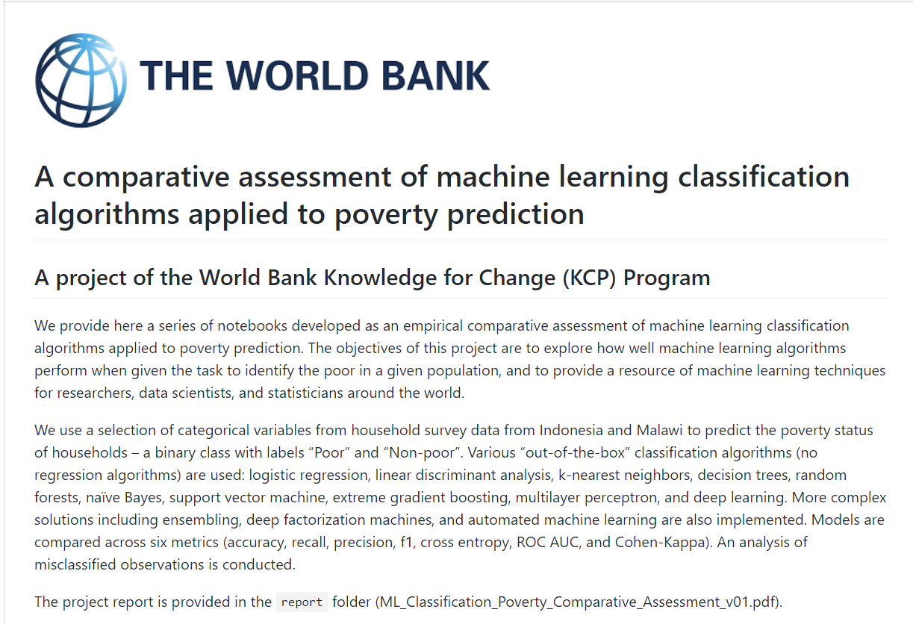

Slide 5

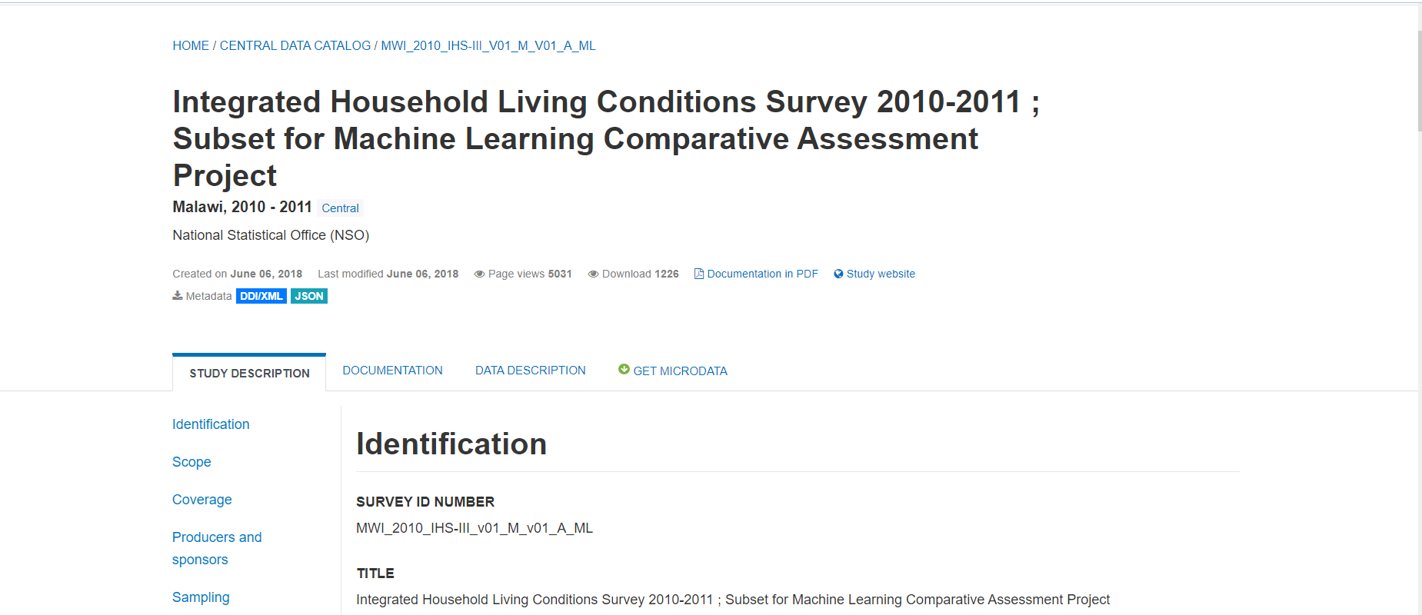
Data Source: World Bank Microdata Library

Slide 6
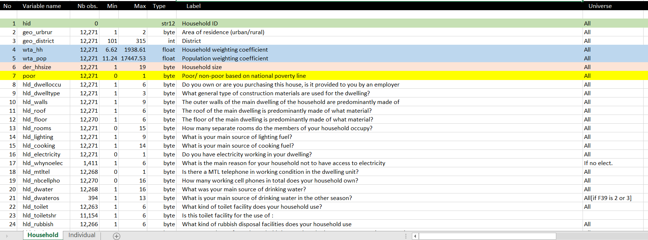
Malawi 2010 - Household-level information
Data Dictionary – 346 Variables

Slide 7
Variables used to assess ML Models (recommended)

Slide 8
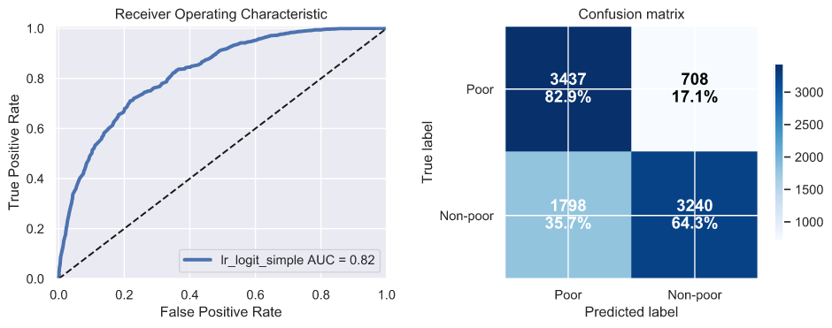
Logistic Regression Classifier – Training Data Results

Slide 9
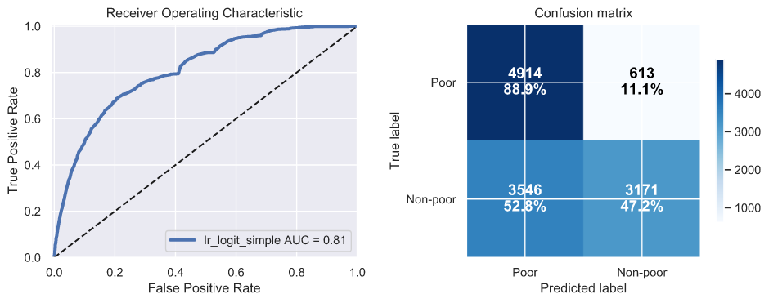
Logistic Regression Classifier – Testing Data Results

Slide 10
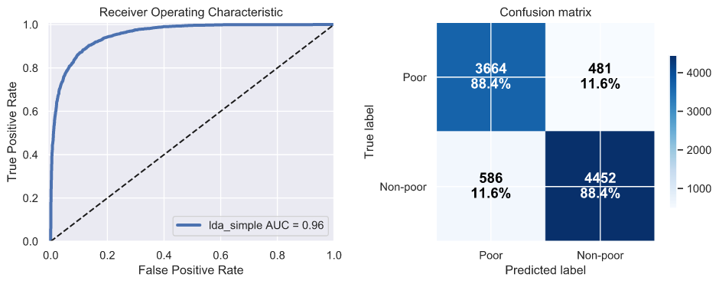
Linear Discriminant Analysis – Training Data Results

Slide 11
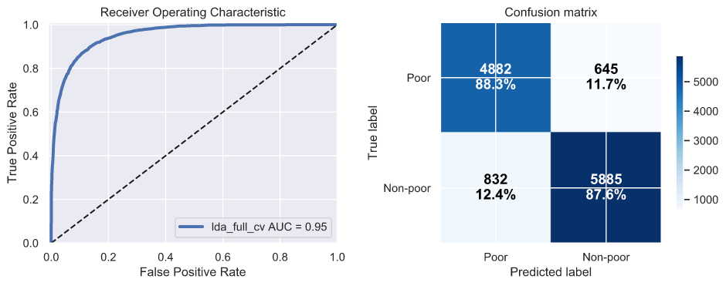
Linear Discriminant Analysis – Testing Data Results

Slide 12
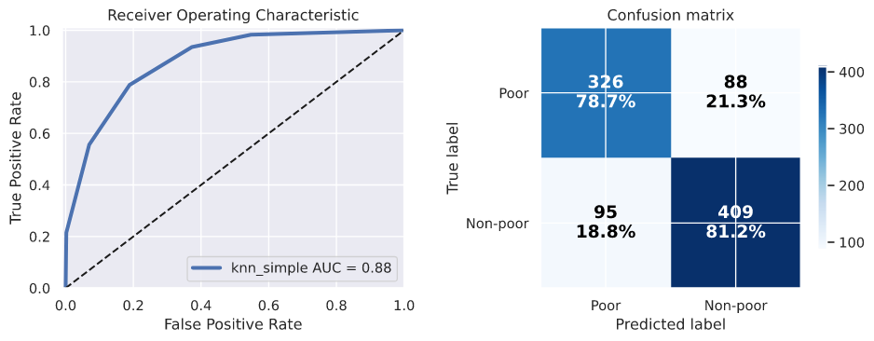
K-Nearest Neighbours Classifier – Training Data Results

Slide 13
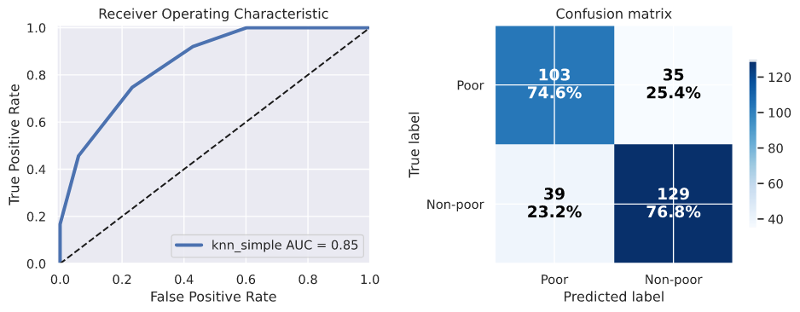
K-Nearest Neighbours Classifier – Testing Data Results

Slide 14
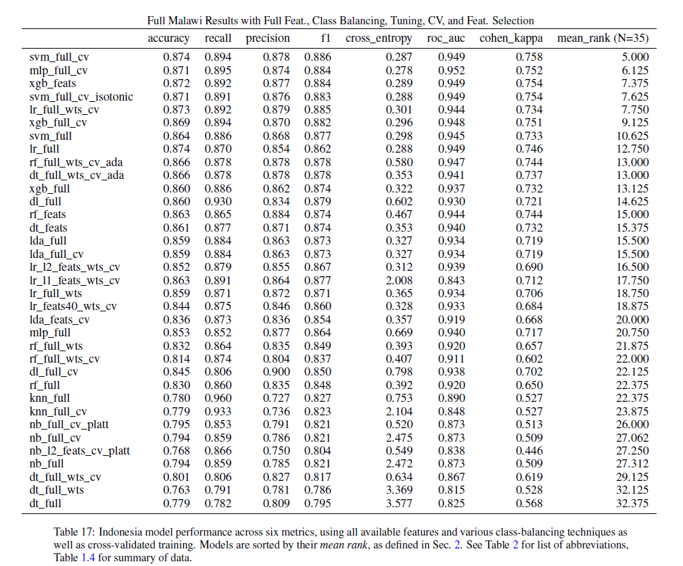
Published Results for Machine Learning Models for Malawi Integrated Household Survey (IHS) Program 2010/11

Slide 15
Issues Assessing the ML Models:
- Only a single survey from a previous country was available to prove the reliability of the model:
Integrated Household Living Conditions Survey 2010-2011 - Malawai
- The small datasets effected the accuracy of Decision Tree and Random Forest Models
- Models where only tested with a limited number of variables:
referred to as simple variable set in the literature

Slide 16
Next Steps:
Collate data from 3 separate surveys:
Integrated Household Living Conditions Survey – Malawai
2010 - 2013 - 2016 (Single dataset)
Classify the data: poor & non –poor based on published poverty line for each of the survey years (2010 as example)
Begin modelling and benchmarking 2010

